Slide 1












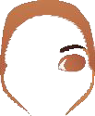






































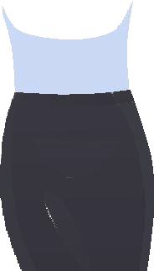




















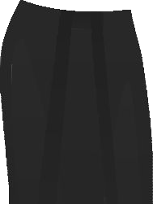














Student Orientation

Slide 2

AQUIFER CASES

Slide 3
Cases: Value Message
Slides 4 & 5
Notes:
(Note: This is for facilitators) Slides 4 and 5 offer the value proposition to students.

Slide 4

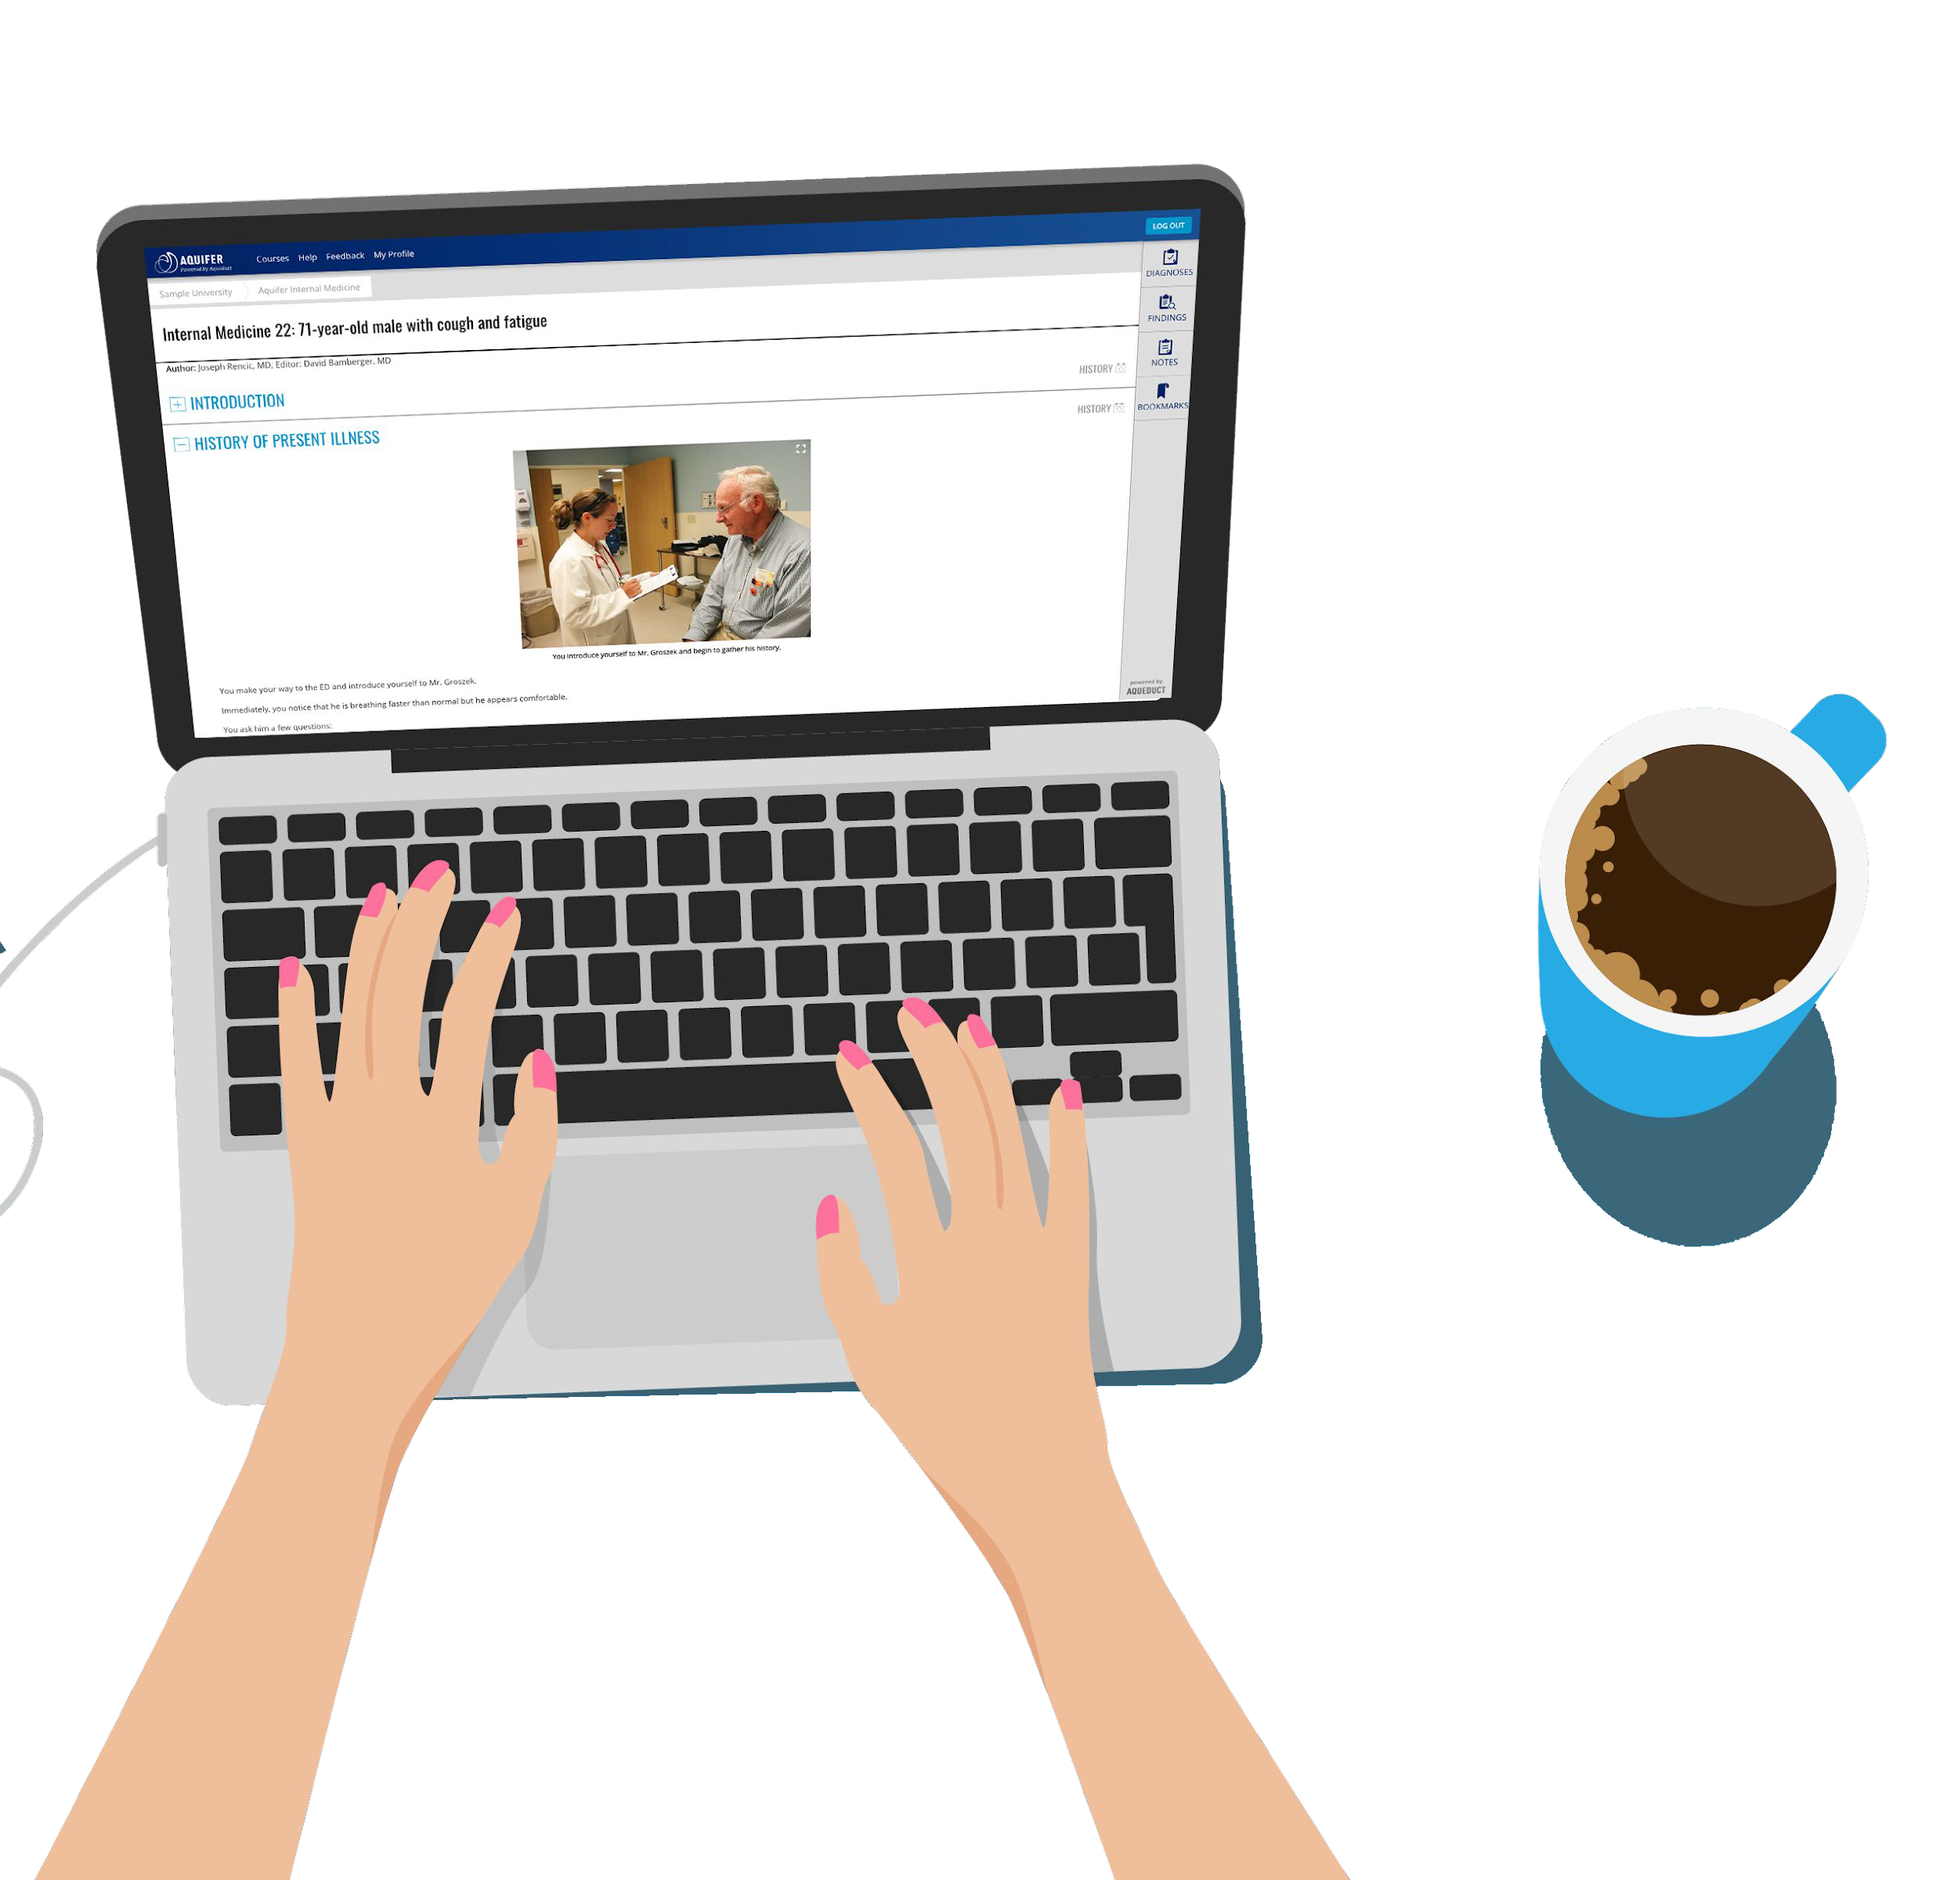
Value: What can Aquifer cases do for me?
Enhance clinical reasoning through realistic cases
Practice medical writing skills
Prepare for an upcoming and/or an away rotation/clinical/practicum
Prepare for end-of-rotation exams
Aquifer | 2
Notes:
(Note: This is for facilitators) Dating back to 2000, Aquifer cases were developed to address a concern clerkship directors discovered: students on rotation may not have consistent access to patients. Students weren’t always seeing similar conditions. And preceptors didn’t always have the time they needed to talk students through the key components of each patient’s situation.
Aquifer cases can help you enhance your clinical reasoning through realistic cases written by health professions educators who align the case content to national curriculum in Family Medicine, Internal Medicine, Pediatrics, Radiology, Geriatrics, Radiology, Neurology, and OBGYN. Cases help you refine your skill interpreting patient encounters and hone your medical writing skills. All of these skills are necessary as you prepare for away rotations/clinicals or practicums and end-of-rotation exams.

Slide 5

A walk through the process of
a complete patient encounter
Aquifer cases give you:
HISTORY
PHYSICAL EXAM
DIFFERENTIAL
DIAGNOSIS
DIAGNOSIS &
TREATMENT
MANAGEMENT
Notes:
(Note: This is for facilitators) There are a broad library of cases and case sets to cover the majority of core clinical rotations. Aquifer cases walk through each step of a patient encounter, from history, to physical, developing a differential, ordering additional tests, forming a final diagnosis, and treating and managing the patient. Inside an Aquifer Case, you can:
Write or edit your diagnosis
Record findings
Take notes
Bookmark information for later
View the patient's lab values
(Note: Adjust this list to your subscription) Signature cases include Pediatrics, Family Medicine, Internal Medicine, Geriatrics, Radiology, OBGYN, and Neurology).
(Optional, depending on your subscription) There are over 50 clinical excellence course topics which cover Palliative Care, Trauma-Informed Care, Diagnostic Excellence, High Value Care, Social Determinants of Health and Telemedicine. These cases are shorter, more focused applications cases which take approximately 15-20 minutes to complete.
Consider Aquifer cases and courses as a virtual preceptor who can check your knowledge and provide an engagement point when you may not have access to conditions or diseases during rotation.

Slide 6
Cases being assigned include:
Notes:
(Note: This is for facilitators) The following slide may be used at your discretion.
Demo-slides 7 & 8
Student FAQ- slide 9
Mobile access- slide 10

Slide 7
Cases: Additional Slides
Demo-slides 8 & 9
Student FAQ- slide 10
Notes:
(Note: This is for facilitators) The following slide may be used at your discretion.
Demo-slides 7 & 8
Student FAQ- slide 9
Mobile access- slide 10

Slide 8
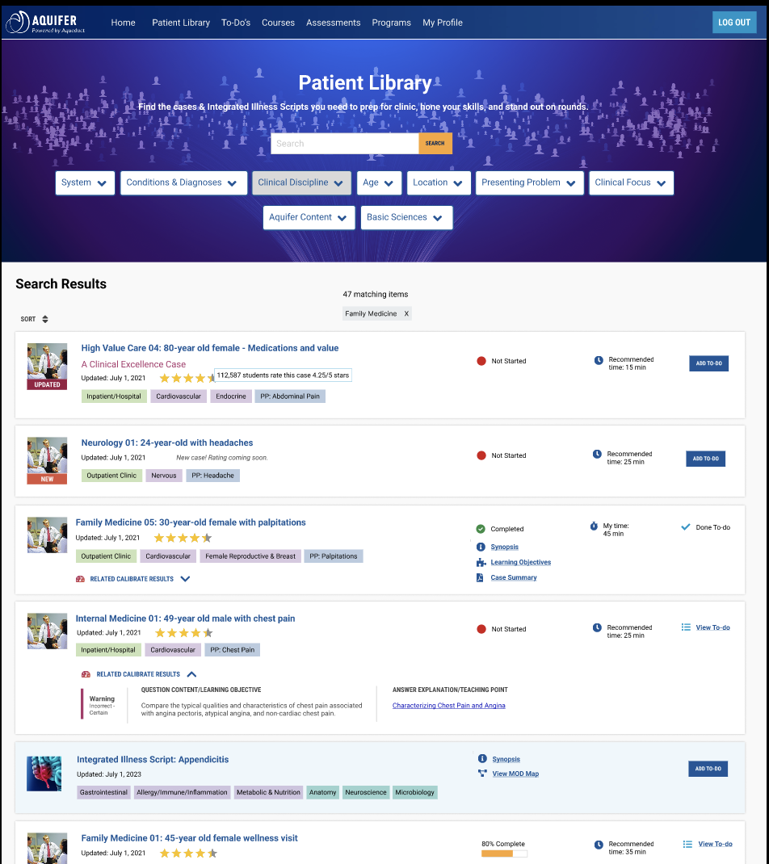
SEARCHABLE PATIENT LIBRARY
Find cases to prepare for rotations
Personalize study plan targeting knowledge gaps
Practice writing summary statements
Use cases to build quizzes
Notes:
(Note: This is for facilitators) You have access to over 200 patient cases. Each case will provide a recommended completion time. If you don’t have time to complete a case, you can add the case to your personalized to-do list.
Aquifer’s LMS, called Aqueduct, contains a patient library allowing you to search and filter content using various parameters such as free text search, system, condition, diagnosis, clinical discipline, age, location, presenting problem, clinical focus, and basic sciences. You may further filter cases with Summary Statements providing you additional opportunities for honing your writing skills.
The number of results will display in the middle of the screen. The result list contains not only the title, but the date the case was last updated. All Aquifer cases are written by a Consortium of health professions educators who adhere to the national curriculum learning outcomes for each clinical discipline. Metadata tags provide a quick look at the clinical location, body system, and presenting problem of the case. The recommended time on case is displayed. An option to add cases to your To-Do list is displayed on the far right side.

Slide 9
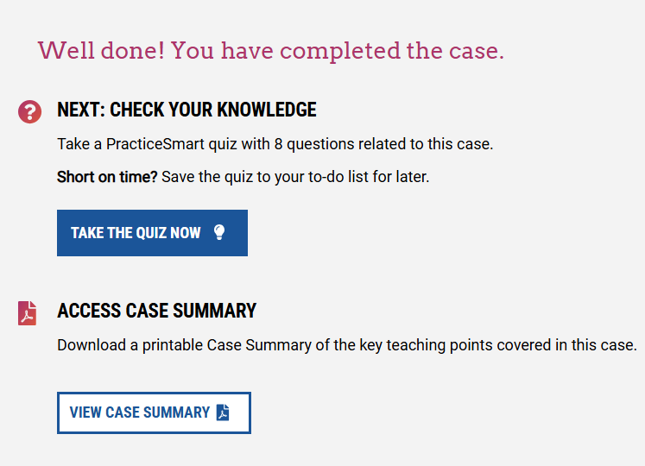
CASE COMPLETION
Your feedback ensures Aquifer case quality improvement
Simplify your notetaking! Case summaries are a study tool
Begin taking PracticeSmart questions
Notes:
(Note: This is for facilitators) Upon case completion, you will have an opportunity to provide feedback for the case. Your feedback is sent to Aquifer who reviews feedback for quality improvement. Also available will be a case summary time and date stamp. Case summaries include:
Learning objectives
Key clinical knowledge
Clinical skills and management
Relevant studies and references
Many cases have PracticeSmart quiz questions allowing you to jump right in to test your knowledge of the core learning concepts presented in the case.

Slide 10





Student FAQs
The picture can't be displayed.
How do I access Aquifer cases?
Use the Sign In button in the upper right side of Aquifer’s webpage, Aqueduct is the LMS students will log into. They will complete Profile and password login credentials.
How do I see what cases I’ve completed?
Students will see a progress bar showing their progress in each case or Integrated Illness Script. Student Reports are accessible for each case.
Can I retake cases?
Students may reset their own cases if their program allows this. Check with your faculty member.
How can I make sure the case is marked complete?
Select the Finish Case button in the Case Summary download. Completed cases show on all faculty reporting as a green circle with a check mark.
Notes:
(Note: This is for facilitators) The following slide highlights commonly asked student questions and answers about Aquifer cases.

Slide 11


Slide 12
PracticeSmart: Value Message
Slides 13
Notes:
(Note: This is for facilitators) Slide 13 presents the PracticeSmart value proposition for students.

Slide 13
What can PracticeSmart do for me?
Test bank which helps you identify your true knowledge gaps and strengths
Helps you prioritize your time spent on cases
Prepare for end-of-rotation exams
Aquifer | 2
Notes:
(Note: This is for facilitators) PracticeSmart is a new question bank and quiz generator. This is an ungraded, unproctored formative assessment allowing you to prepare for your end-of-rotation exams. Similar to the test bank products you use regularly, there are 1,000+ NBME board style vignette questions. However, each PracticeSmart question will also ask you to rate your confidence of your answer choice. Every question and explanation connects back to an Aquifer case, so you can prioritize your time spent on case(s)of which your knowledge may be misaligned.
Educators do not have access to student performance results
(Optional depending on your subscription) PracticeSmart is an ideal complement to our Calibrate assessments.

Slide 14
Cases: Additional Slides
Getting Started-slides 15-17
End of Case- slide 18-19
Quiz Generator- slide 20
Results- slides 21-22
Notes:
(Note: This is for facilitators) The following slides may be used at your discretion
Getting Started-slides 15-17
End of Case- slide 18-19
Quiz Generator- slide 20
Results- slides 21-22

Slide 15
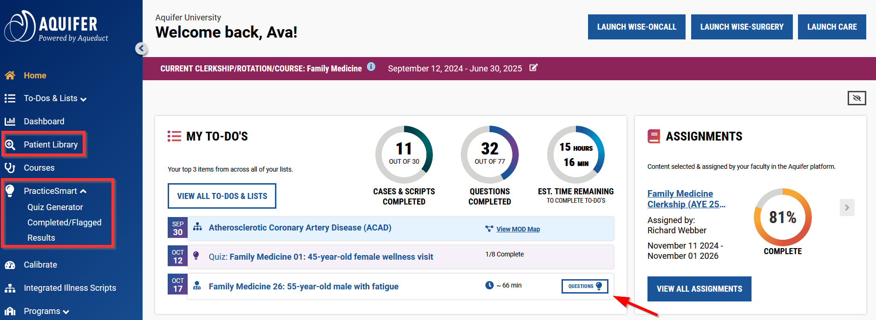
Getting Started
The picture can't be displayed.
Notes:
(Note: This is for facilitators) To get started, sign in to your Aquifer account. You have access to all PracticeSmart questions associated with your subscribed content.
There are 3 ways to access PracticeSmart questions:
• Within a Case- At the end of the case, you'll see options to open questions or save them to your to-do list. The "Questions" button is also available at the top of the page for easy access.
• From Case Lists- In Patient Library, courses, and your To-Do list, look for the "Questions" button associated with your cases to jump to the related quiz or save it to your to-do list.
• From the Quiz Generator- Use the side navigation to jump to the Quiz Generator to customize your self-assessment to meet your needs.

Slide 16
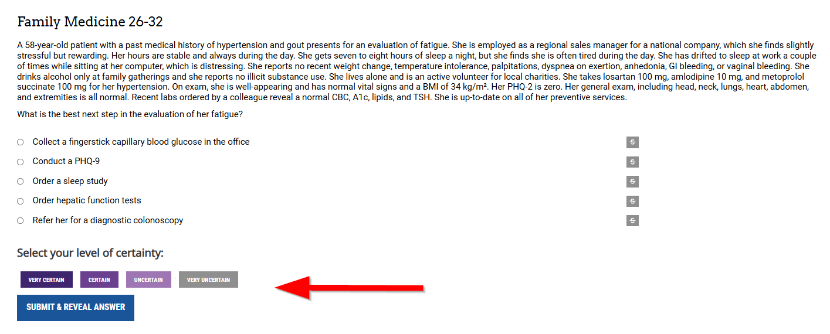
More Than Just Another Test Bank
The picture can't be displayed.
Notes:
(Note: This is for facilitators) When you are presented with a question, you will see:
● Vignette and question
● 5 multiple choice answers (single best answer)
● Certainty rating
● Submit button
Courses without SAQs are within the Clinical Excellence case sets (Diagnostic Excellence, Social Determinants of Health, and Telemedicine) and Oral Presentation Skills.
The Question player allows students to use the strikethrough feature to rule out answers. You must select both your answer and your level of certainty. Then you click submit to move to the next stage of their experience (depending on the mode selected). Faculty cannot see the list of your quiz questions chosen.

Slide 17
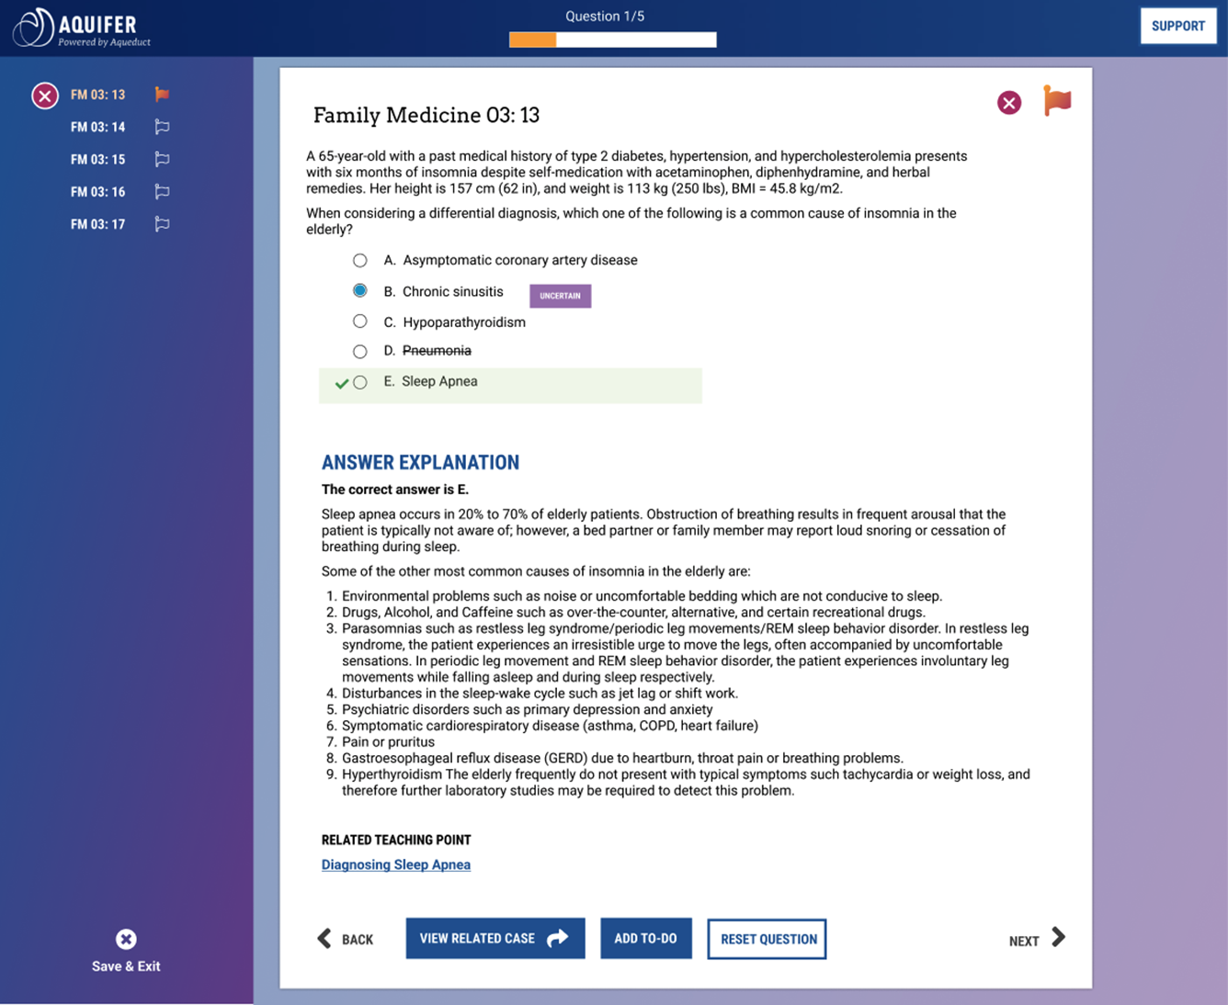
Answer Review Display
The picture can't be displayed.
Notes:
(Note: This is for facilitators) After completing a question (study mode) or all questions (quiz mode), you will be able to review the answer and answer explanation for each question.
This display includes the vignette and question, all possible answers, and:
● Accuracy indicator in sidebar and top right of question display (red x for incorrect, green check for correct)
● Flag for review button (click to flag/unflag)
● Green check mark next to correct answer for question; green highlight
● Answer explanation
● Teaching point (full text of teaching point opens in modal)
● Buttons to:
○ Add to-do (Manage to-do shows if the related case or questions are already on the student’s to-do list)
○ View related case (opens case in new tab)
○ Reset question (Deletes answer, resets question so it can be answered again)]
■ A confirmation modal appears to ensure the user intended this action and to clarify that all current work will be deleted.

Slide 18
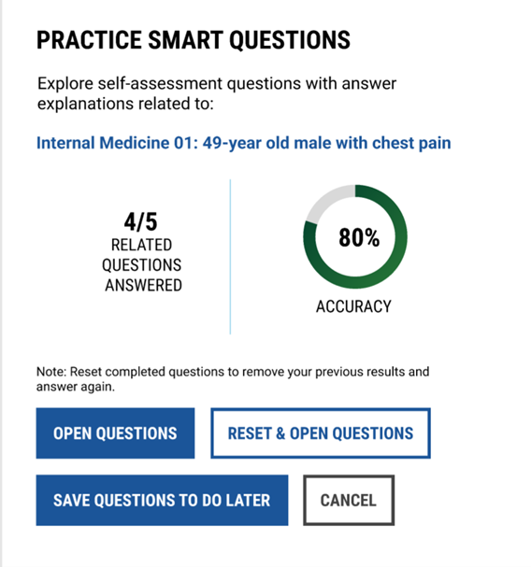
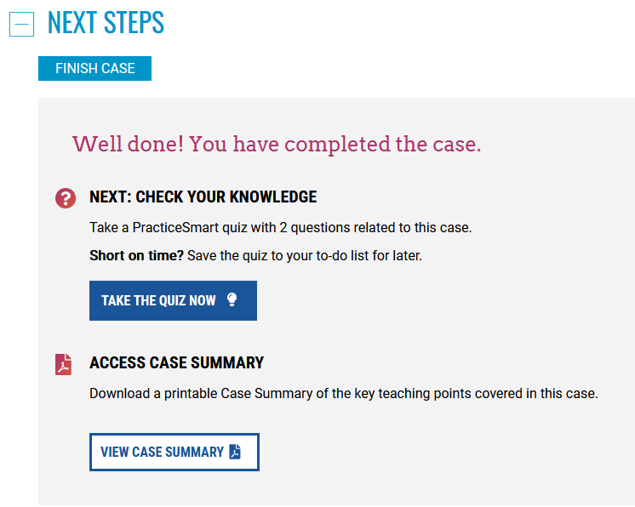
Choose Your Journey: End of Case
Choose Your Journey: End of Case
The picture can't be displayed.
Notes:
(Note: This is for facilitators) One of the ways to access Practice Smart questions is at the end of a case. This may be a case you choose from the Patient Library. At the end of the case, you'll see options to begin questions or save them to your to-do list.
If no questions have been completed, the question player opens right away. If some or all questions are completed, this modal will show the number of questions answered and accuracy chart. You can choose to:
● Open questions: Opens all related questions in the question player in their current state (completed or not completed or a mix)
● Reset and open questions: Resets any completed questions and opens the question player
● Save questions to-do later: Adds a quiz to their to-do list
● Cancel: Closes the modal
After the “start question set” button is clicked, a modal appears requiring the student to give the quiz a name. Quiz names must be unique. After submitting the quiz name, the question player opens.

Slide 19
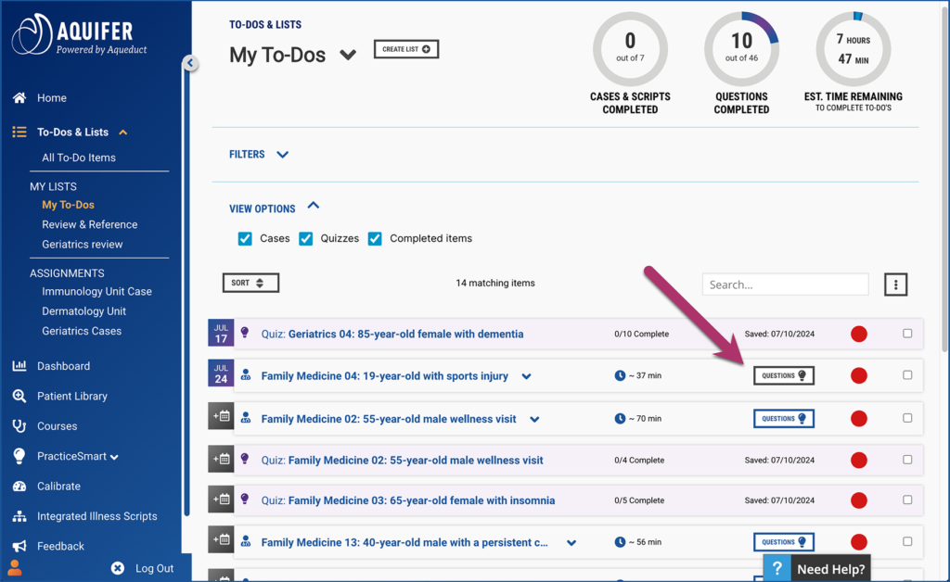
Choose Your Journey: Case List
The picture can't be displayed.
Notes:
(Note: This is for facilitators) Prioritize work by jumping to the quiz first by clicking on the “Questions” button associated with a case in your To-Do List. Cases may be ones you have determined or a case your instructor has chosen.
Each question maps to the following fields:
● Course
● Case
● Learning objective
● Teaching point
● Body system
● Clinical focus
● Clinical discipline
● Clinical location (optional)
● Patient age (optional)
● Final diagnosis (optional)

Slide 20
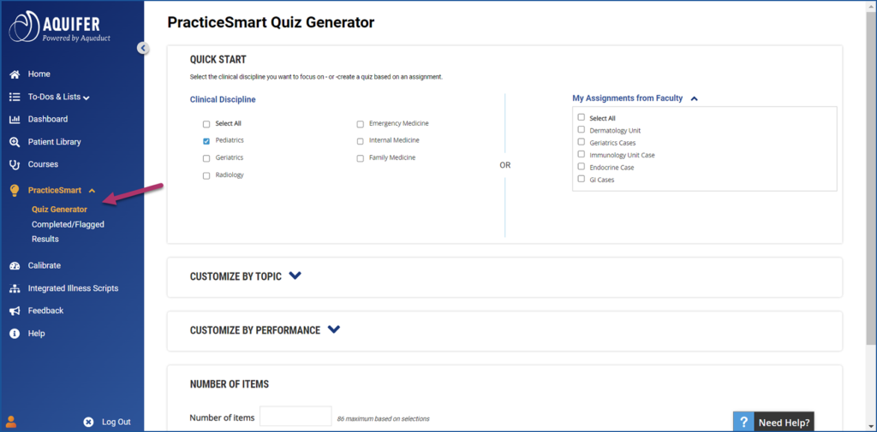
Choose Your Journey: Quiz Generator
The picture can't be displayed.
Notes:
(Note: This is for facilitators) You can create their own quiz using the PracticeSmart Quiz Generator, accessible from the side navigation. The Quiz Generator is limited to the program’s subscribed content. Create custom quizzes to focus on the areas you need with filters - by discipline, system, clinical focus, and even diagnosis. At the end of your course or rotation, or for licensing exam prep, go broad in the area/areas you will be covering to check your knowledge and fill any remaining gaps.
The only required field on the page is the number of items. If you select only the number of items, the quiz will generate from a random selection of all available items. The Quick Start card at the top of the page includes easy ways to focus your learning. Clinical discipline selection
■ If clinical discipline matches your current course (ie. Pediatrics & Pediatrics), the box will be auto-checked
■ If your current course does not match a clinical discipline, no options are autochecked, you can make the selection that best fits your needs
“My Assignments from Faculty” selection
■ Allows you to create a quiz based on one or more custom courses. The dropdown field will show all custom courses available to the student with checkboxes.
■ This dropdown should only show if your faculty has assigned custom courses.
If you want a more customized quiz, expand the Customize by Topic or Customize by Performance cards.

Slide 21
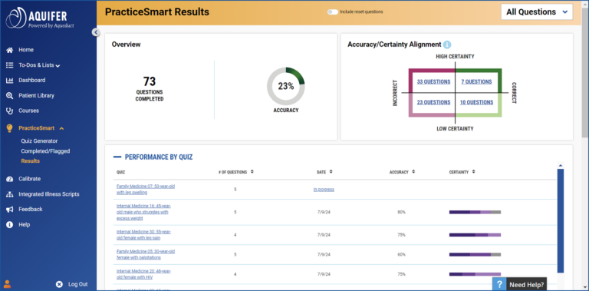
Results & Next Steps
The picture can't be displayed.
Notes:
(Note: This is for facilitators) PracticeSmart results are displayed for your individual quizzes as well as for all work you have completed in PracticeSmart. You can access the individual quiz results from the end of their question player experience by clicking on the “View Results Summary” button.
You can also navigate to the results from the side navigation (PracticeSmart→ Results). By default, you will land on the summary results for all of PracticeSmart (All Questions option in the dropdown). You can use the dropdown at the top of the page to toggle their view to individual quiz results.
The results screen is designed to show you at a glance how they performed on the quiz, and allow you to easily identify areas where you may want to focus additional study. The Overview card includes:
Total questions completed for this view
Date completed (individual quiz view only)
Accuracy percentage donut shows the % correct on the associated quiz, or for all questions
Quadrant display aligns accuracy and certainty by showing how many questions you completed that fall into each section of the quadrant (incorrect/correct, high certainty/low certainty). You can click on the link for each number of questions to view a list of all of the details (shows question, answer, answer explanation).
You can view a summary of all of their PracticeSmart performance by using the dropdown toggle in the upper right corner of the screen. This dropdown will list all quizzes created in the Quiz Builder, along with the “All Questions” option, which shows all PracticeSmart performance. Note: Results from individual case quizzes are not listed here or displayed in this results format. They are included in the “All questions” summary. Accuracy percentage for individual cases can be viewed from the “Questions” button in the modal that appears.

Slide 22
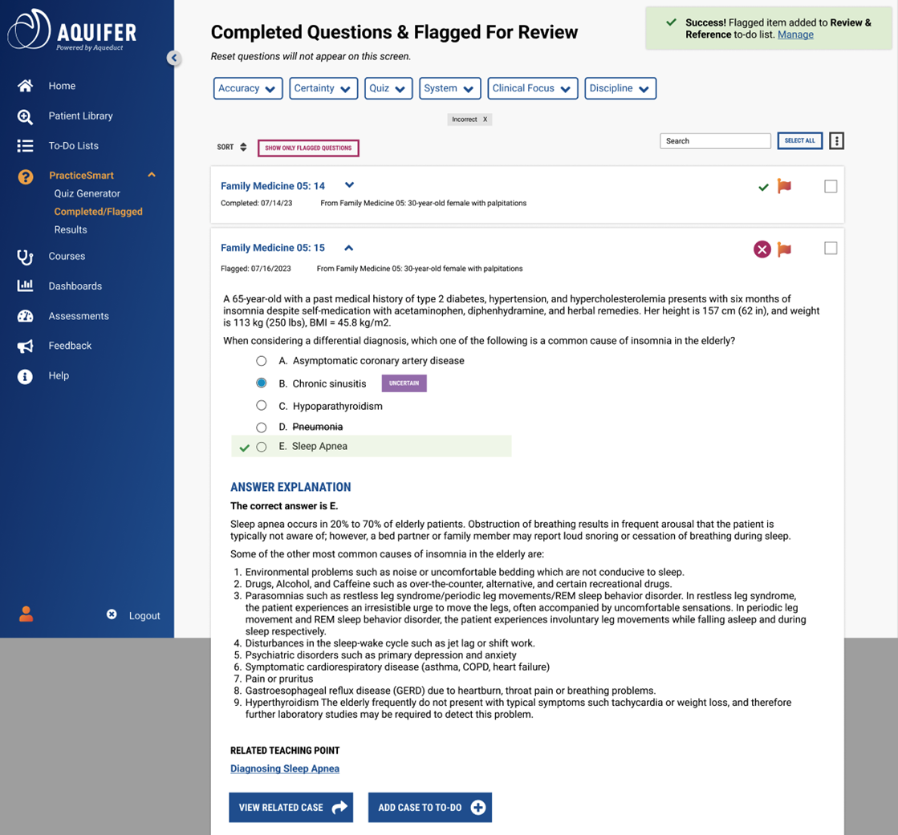
Completed Question Display
The picture can't be displayed.
Notes:
(Note: This is for facilitators) The question view mirrors the display in the question player. The collapsed view shows the question name, the date completed or flagged, and the related case name. It also includes a checkbox to select the question. The expanded view mirrors the display in the question player, showing:
● Accuracy indicator
● Flag button
● Question
● Answer options
● Student selected answer and certainty rating
● Correct answer
● Answer explanation
● Teaching point link
● View related case button (opens in new tab)
● Add/Manage to-do button (opens modal)
You can easily flag questions for review while reviewing answers and answer explanations. This will allow you to easily find and reference the question again. Questions can be flagged for review from:
● Question player (for individual completed questions)
● Completed Questions & Flagged for Review page
To flag a question, you click the flag icon at the top of the question card. When the flag is orange, it is “flagged”. Flagging a question triggers the following:
● Will be visible as flagged on the Completed Questions & Flagged for Review screen for easy sorting
● Added to the “Review & Reference” to-do list
○ You can change this or move the item to a different list by clicking on “Manage” in the success message that appears after flagging.

Slide 23


Slide 24
Calibrate: Value Message
Slide 25 -26
Notes:
(Note: This is for facilitators) Please use this slide at your discretion.

Slide 25
What can Calibrate assessment do for me?
Helps you prioritize your time spent on cases
Identify where you already excel and your knowledge gaps.
Provides checkpoints to track your progress
Prepare for end-of-rotation exams
Aquifer | 2
Notes:
(Note: This is for facilitators) Calibrate formative assessment is specifically designed to help you focus on high-yield learning to support your clinical course success. Calibrate is an ungraded assessment deployed by your instructor, which is designed to expose blind spots where your confidence and accuracy are misaligned. This is different from graded assessments or exams you taken. Calibrate questions align with the national medical student clerkship curriculum of family medicine, internal medicine, pediatrics, neurology, and radiology. PracticeSmart is a question bank and quiz generator which you can control the type and number of questions you want to answer.
This is not another test bank. Aside from choosing the correct answer, you’ll be rating your certainty of your answer choice. Your Calibrate results account for your Accuracy, certainty, and efficiency of each question. Calibrate helps you identify where you already excel; conversely identify your knowledge gaps.
Designed to be taken twice during a rotation or course, Calibrate provides structured checkpoints along the way to be sure you’re on track before the end of your course–and your final exam. Your faculty member will choose when Calibrate will be deployed.
This is an ungraded, unproctored assessment allowing you to prepare for your end-of-rotation exams.

Slide 26
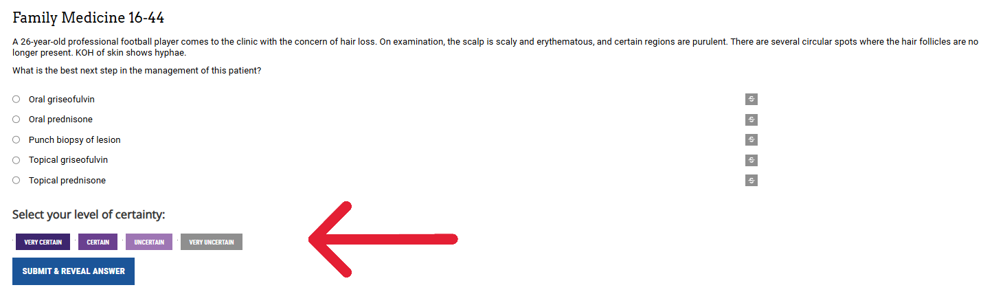
Assessment for Learning not of Learning
The picture can't be displayed.
Notes:
(Note: This is for facilitators) Calibrate contains single answer, board style vignette multiple-choice questions with a certainty rating for each question. Certainty rating adds a new dimension—beyond right or wrong answers—to provide a more complete picture of your understanding. Each assessment contains approximately 35-45 question which are designed to be completed in about an hour. You will have a window of 10 days to complete a Calibrate assessment (and this window covers weekends). Once you begin an assessment, you may pause the assessment for up to 10 minutes. Beyond 10 minutes, then the assessment will mark your assessment as autocompleted.

Slide 27
Reports: Additional Slides
Results Overview-slides 28
My Progress Overview- slide 29
Calibrating Knowledge & Certainty- slide 30
Bonus- slide 31
My Learning Plan- slide 32
Tutorial- slide 33
Technical Support- slide 34
Mobile Access- slide 35
Notes:
(Note: This is for facilitators) Please use these slides at your discretion.
Results Overview-slides 28
My Progress Overview- slide 29
Calibrating Knowledge & Certainty- slide 30
Bonus- slides 31
My Learning Plan- slide 32
Tutorial- slide 33
Technical Support- slide 34

Slide 28
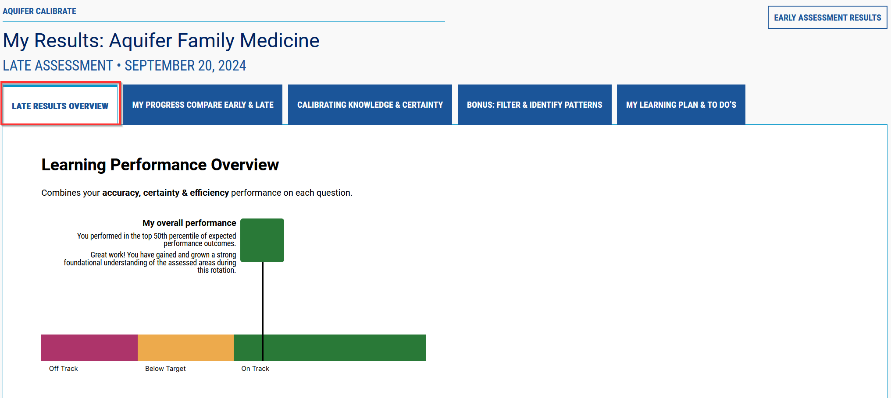
Reports: Results Overview
Notes:
(Note: This is for facilitators) You will see as many as five tabs for each of your Calibrate assessments. The first tab is Results Overview which provides your overall performance in comparison to your national peers. Your results are measuring your accuracy, certainty, and timeliness for your answer selection.
If you completed both an Early and Late Assessment, you will see another tab titled, “My Progress Compare Early & Late.” This tab, if present, will provide a summary of performance & comparison between both your early & late assessments.
Consider using your Calibrate results to select PracticeSmart questions which address blind spots where your confidence and accuracy misalign. Moreover, you may also search your Patient Library to find cases which address your knowledge cloud of knowing-what-you-don’t-know.

Slide 29
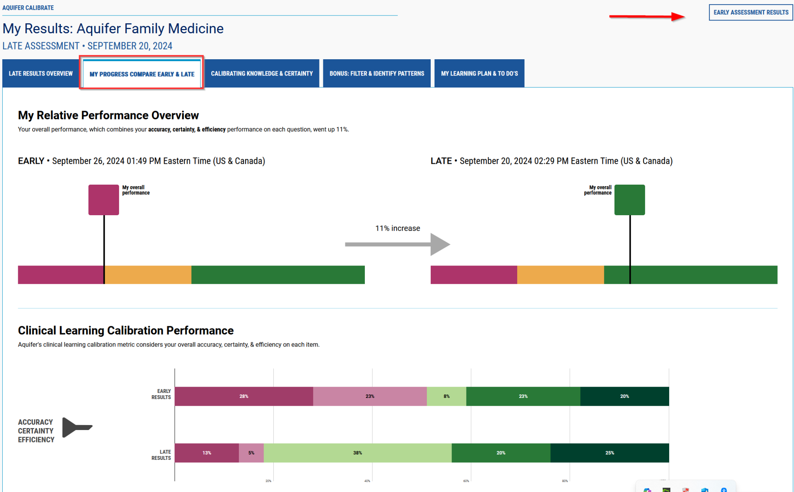
Reports: My Progress Compare Early & Late
Notes:
(Note: This is for facilitators) If you completed both an Early and Late Assessment, you will see a 2nd tab titled, “My Progress Compare Early & Late.” This tab, if present, will provide a summary of performance & comparison between both your early & late assessments.
Select the “Early Assessment” button in the upper right to return to your previous assessment results.
Your Clinical Learning Calibration Performance metric will display highlighting your overall accuracy, certainty, & efficiency on each item.

Slide 30
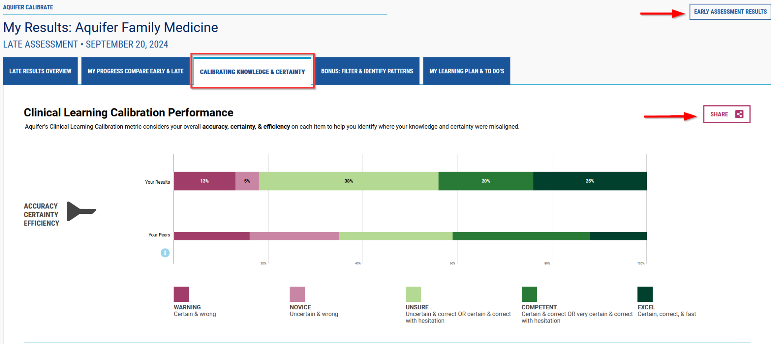
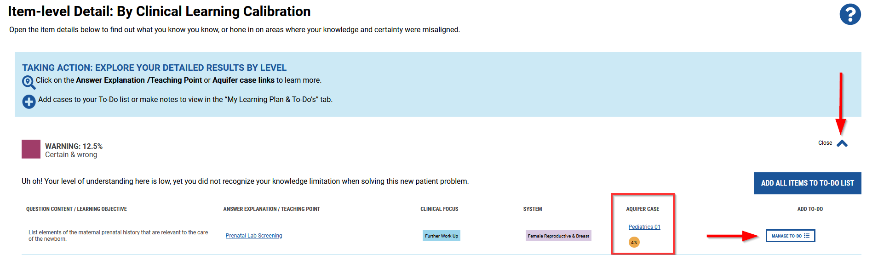
Reports: Calibrating Knowledge & Certainty
Notes:
(Note: This is for facilitators) The “Calibrating Knowledge & Certainty” tab provides the Clinical Learning Calibration metric to help you identify where your knowledge and certainty were misaligned. You have the ability to revert to a previous assessment in the upper right button. Moreover, you may share this tab with a faculty member or preceptor. Select the “Early Assessment” button in the upper right to return to your previous assessment results.
Within the Item-Level Detail section in the second half of the page, explore your detailed results by calibration level. Select the carrot next to each each level to open the item details below to find out what you know, or hone in on areas where your knowledge and certainty were misaligned. The answer explanation/teaching point are hyperlinked as is the Aquifer case which you may go immediately back to for self-directed learning.
Add cases to your To-Do list or make notes to view in the “My Learning Plan & To-Do’s” tab.

Slide 31
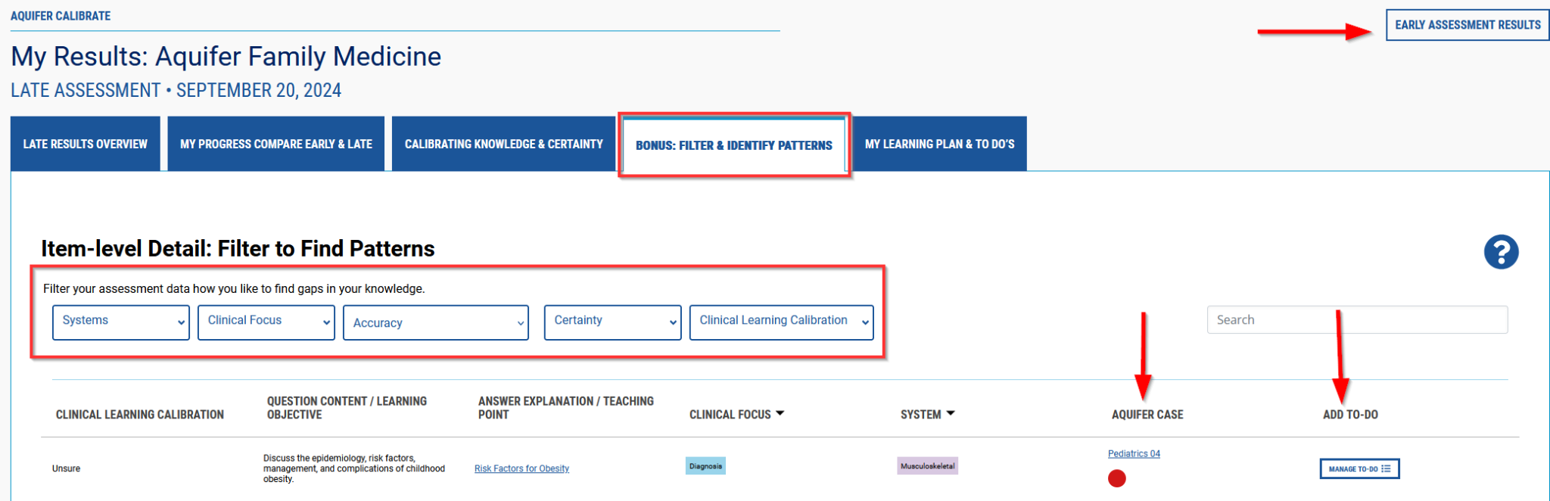
Reports: Bonus: Filter & Identify Patterns
Notes:
(Note: This is for facilitators) The “Filter & Identify Patterns” tab allows you to filter your assessment data to find gaps in your knowledge. Select the “Early Assessment” button in the upper right to return to your previous assessment results.
There are seven columns displaying your clinical learning calibration; question content/learning objective; answer explanation/teaching point; clinical focus; system; Aquifer case; and Add To-Do. Each of the “Item-level Detail” buttons allows you to sort the report to view areas that were not accurate or lacked certainty.
Select the Aquifer case which relates to the Answer Explanation/Teaching Point for each Question/Content/Learning Objective. You may also search your Patient Library to find cases which provide additional practice to misaligned gaps.
Add items to your To-Do List for later completion. Consider using your Calibrate results to select PracticeSmart questions which address blind spots where your confidence and accuracy misalign.

Slide 32
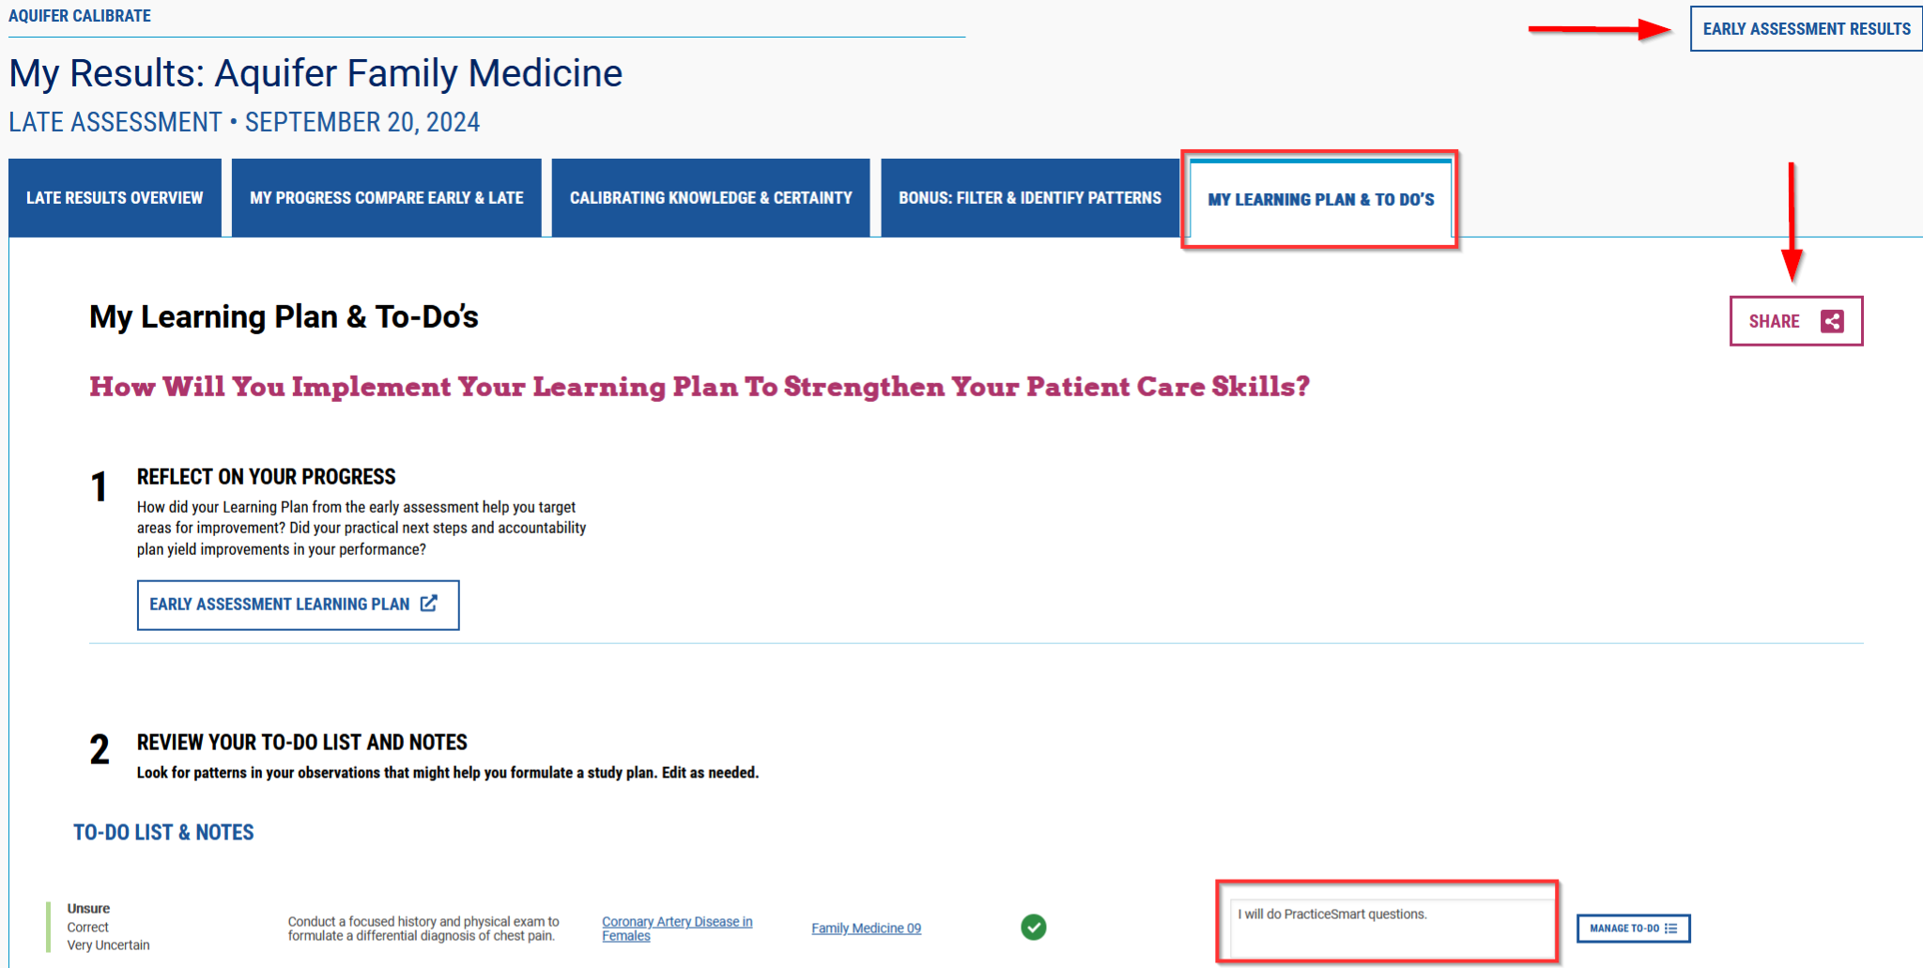
Reports: My Learning Plan & To Do’s
Notes:
(Note: This is for facilitators) The “ My Learning Plan & To Do’s” tab allows you to see the cases appendaged with your notes. Select the “Early Assessment” button in the upper right to return to your previous assessment results.
Reflect on your results to find key insights, determine your next steps, and create an accountability plan. Consider which goals are most important for you to focus on. Name action steps to help you achieve your priority goal. Consider small steps that can get you there.
You may directly share with your faculty, learning coach, or preceptor. Your faculty member, learning coach, or preceptor will not receive this report unless you send it to them.

Slide 33
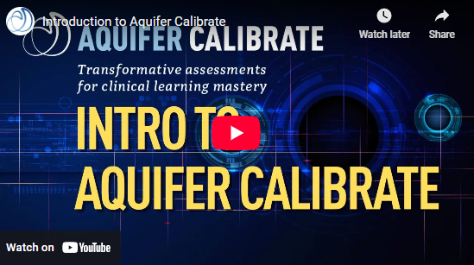
Introduction to Aquifer Calibrate
The picture can't be displayed.
Notes:
This video provides a quick 3 minute tutorial about Calibrate to recap what has been discussed thus far.

Slide 34
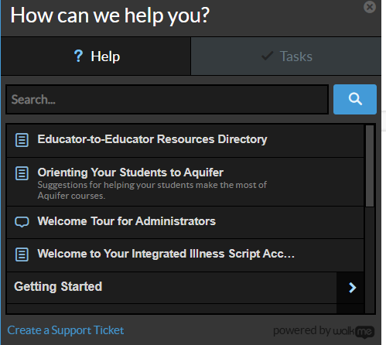
Technical Support
Aqueduct Help
Aquifer Support:
https://aquifer.org/resources-tools/support-ticket/
Notes:
(Note: This is for facilitators) There are multiple ways to find help. If you’re logged into Aqueduct, select the “Need Help” button in the lower right side. Input your topic in the search field. Or Aquifer has a support webpage which you can submit a ticket.

Slide 35
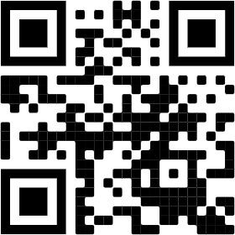


Mobile Access–Anytime, Anywhere
Download the Aquifer Clinical Learning app to complete cases anytime, anywhere—including working offline.
Notes:
(Note: This is for facilitators) Let me remind you that you may access Aquifer cases via the Apple App store or via Google Play. The QR code will take you to Aquifer’s website.

Slide 36
STUDENT DASHBOARD

Slide 37
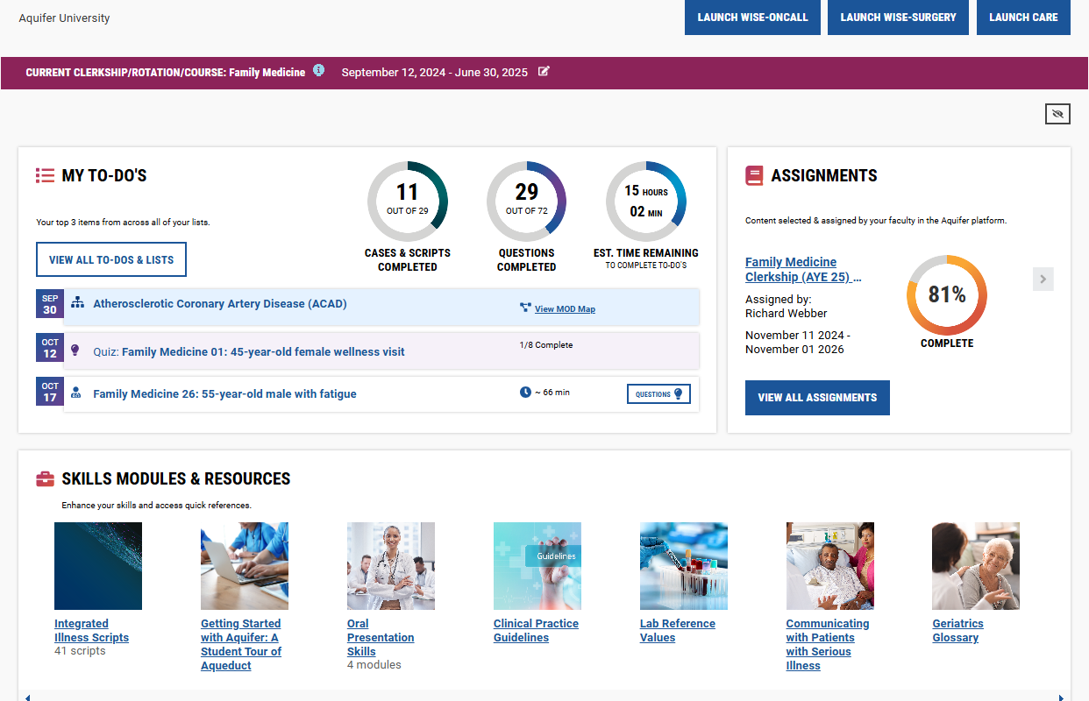
STUDENT DASHBOARD
Notes:
(Note: This is for facilitators) When you log into Aqueduct, Aquifer’s LMS, the landing page of your dashboard will display your To-Do List. You can easily visualize and track your activities, including cases, scripts, Calibrate assessments, and PracticeSmart questions.
The dashboard provides your performance data.
Underneath your To-Do List will include the additional resources within your subscription. All tools are available from the side navigation as well.

