Slide 1





















































































Student Orientation

Slide 2

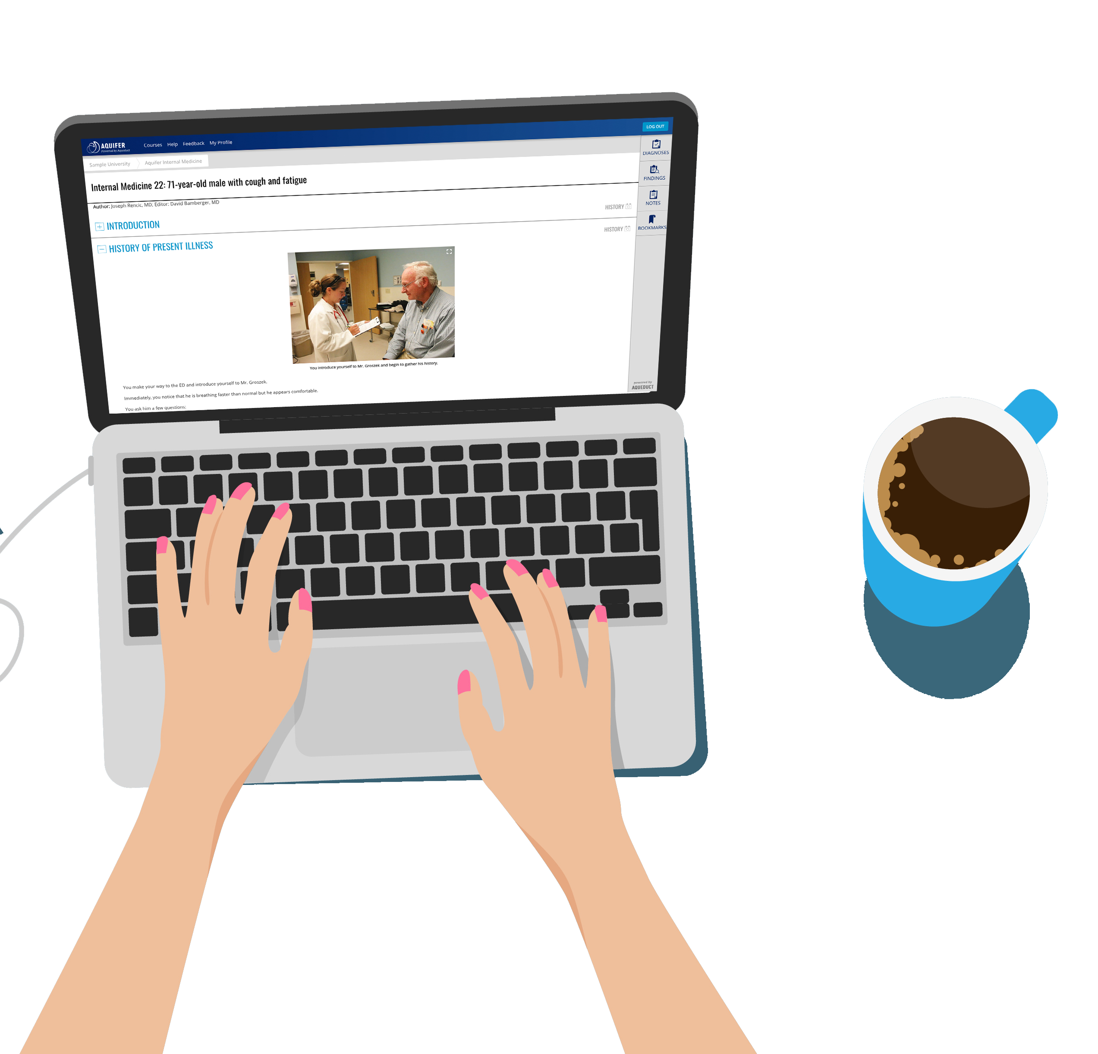
Welcome to Aquifer
Aquifer’s virtual patient cases are designed to:
build clinical decision-making skills
provide deep, realistic patient scenarios
Aquifer | 2

Slide 5





Tips for Using Aquifer Cases
The picture can't be displayed.
Think of each Aquifer case as a real patient.
Consider the cases patients you didn’t get to see, or cases you want to review—at your own pace.
Plan enough time for a thorough review.
Cases are deep—most take 30-45 minutes to complete.
Don’t miss the Case Summaries at the end of each case.
Perfect to save or print as a study guide.
Discussing cases makes connections.
Plan to discuss cases with a friend or study group to maximize your learning—if you aren’t already covering them in class.

Slide 6




Student Story Videos
1 minute stories from your fellow students about how Aquifer helps: aquifer.org/students
Mobile Access–Anytime, Anywhere
Download the Aquifer Clinical Learning app to complete cases anytime, anywhere—including working offline.

